Slide 1
Treatment breakdown for breast cancers
This work has been produced as part of the Cancer Research UK - Public Health England Partnership. Contributors are listed at the end.

Slide 2
Methods 1)
These slides present the numbers and percentages of tumours diagnosed in England in 2013 - 2015 recorded as receiving radiotherapy, chemotherapy or tumour resection. The results are presented by year, stage at diagnosis, age, sex, deprivation, ethnicity, and comorbidities. The stage distribution is presented, followed by the treatment breakdown (independently and in combinations) for each variable.
This work uses data collected by the NHS, as part of the care and support of cancer patients.
Detail on methodology is described in the SOP and workbook (here) and summarised below:
These proportions are unadjusted, so patterns may be caused by differences in stage, deprivation, age, sex, ethnicity, comorbidities or other factors, such as patient choice.
Datasets used to capture treatment information include cancer registration data, the Systemic Anti-Cancer Therapy dataset (SACT), RadioTherapy DataSet (RTDS), and inpatient Hospital Episode Statistics (HES).
A tumour resection is an attempt to surgically remove the whole of the primary tumour.
Radiotherapy includes both curative and palliative teletherapy procedures, and excludes brachytherapy and contact radiotherapy.
Chemotherapy includes both curative and palliative chemotherapy, and excludes hormonal therapy, and other supportive drugs such as zoledronic acid, pamidronate, and denosumab.

Slide 3
Methods 2)
On the graphs which display combinations of treatments received, one of the categories is ‘Other care’. ‘Other care’ represents the group of patients who had no record of chemotherapy, tumour resection, or radiotherapy in the time frame assessed. This may include patients who received other treatments (such as hormonal therapy or management of symptoms), treatment outside of the time frame assessed, treatment in a private setting, or there may be data missing from the datasets used.
The patient's Charlson comorbidity score was derived from Hospital Episodes Statistics (HES) and Cancer Registry data combined, and looks from 27 months to 3 months before the patient's cancer diagnosis.
The patient’s age group was based on the age of the patient when they were diagnosed with the tumour.
The patient’s income deprivation quintile was allocated by linking the patient’s postcode to their 2011 ONS census lower super output area (LSOA). This was then linked to the Ministry of Housing, Communities & Local Government 2015 income deprivation quintile for that LSOA.
Treatments occurring in the period from 1 month before diagnosis to either 6, 9, 12, 15 or 18 months after diagnosis are displayed. The time period within which most patients' first course of treatment occurred varies by cancer site and treatment type. Therefore, an appropriate time period for each cancer site has been chosen using a data-driven approach in consultation with clinicians (see SOP for more information).

Slide 4
Summary of key results 1)
In modern clinical practice, the most appropriate treatment is determined by stage (tumour size and +/- nodal metastases), grade and molecular markers such as oestrogen receptor (ER) and overamplification of human epidermal growth factor receptor 2 (HER2).
Chemotherapy: The vast majority of patients with invasive breast cancer will be recommended resection and radiotherapy and a drug treatment in order to treat occult metastatic disease. The relevance of this is that the results of those non-stage parameters (grade and molecular markers) can mean that certain stage 1 cancers will be treated with chemotherapy (17%). However, given that many stage 1 cancers are oestrogen receptor positive, their systemic drug treatment will be with oral anti oestrogen, and therefore not many will require chemotherapy as well. As stage increases these are more threatening cancers so even though many will be ER positive and be treated with oral anti oestrogens they will also receive chemotherapy as additional systemic treatment as shown in the results (46% of stage 2, 70% of stage 3, 44% of stage 4).
Resection: Most early invasive breast cancer (stage 1-3a) will receive excision of the primary cancer.
Radiotherapy: Breast conservation surgery (where a mastectomy is not performed) is the commonest breast cancer operation and is always accompanied by subsequent radiotherapy to the breast which explains the high levels of radiotherapy shown for stages 1 (69%) and 2 (65%).

Slide 5
Summary of key results 2)
Age: Less chemotherapy is given in older patients, as it is thought that the proportion of tumours that are ER positive increases with age, making oral anti oestrogen a good option and also older patients may not cope as well with any complications that would arise from chemotherapy.
Sex: Men usually receive a mastectomy and as that means less breast conservation surgery, there will be less use of radiotherapy.
Deprivation: The most deprived quintile received more chemotherapy (32% of the least deprived, 38% of the most deprived), less resection (83%, 79% respectively) and less radiotherapy (63%, 61% respectively) than the least deprived quintile.
Ethnicity: Increased chemotherapy in the non-White patients is likely to reflect that triple negative cancers are more common in non-White patients, and the only applicable systemic treatment choice is chemotherapy, as anti oestrogens are of no benefit for triple negative tumours.

Slide 6
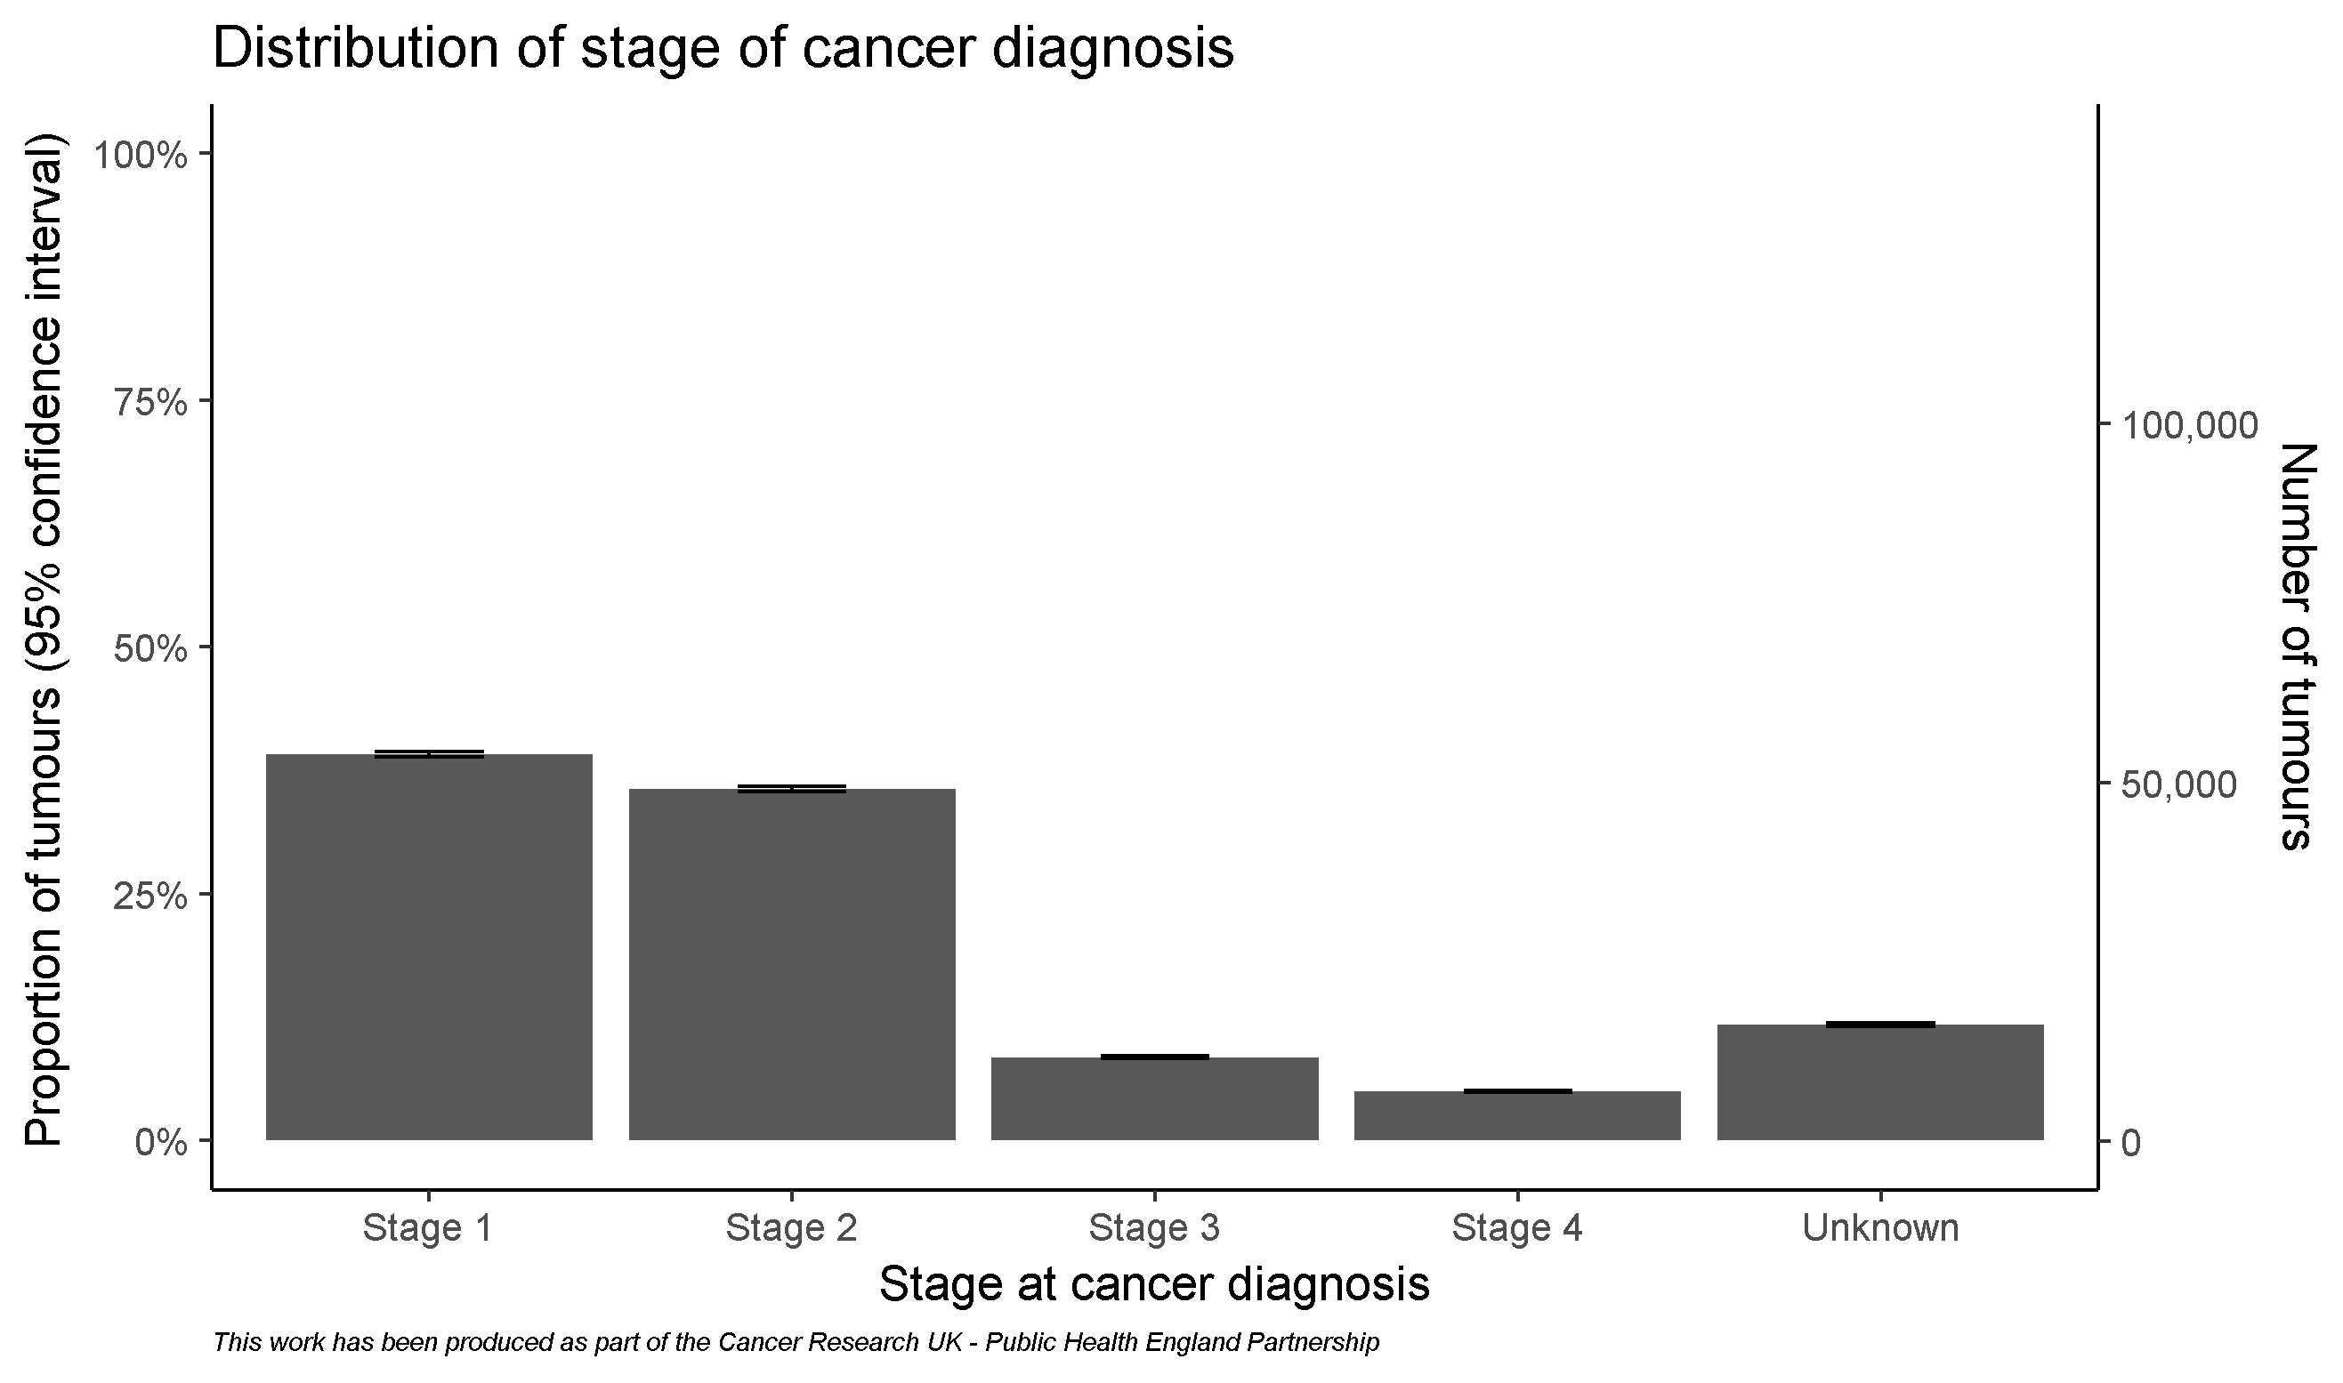
Cohort for breast cancers

Slide 7
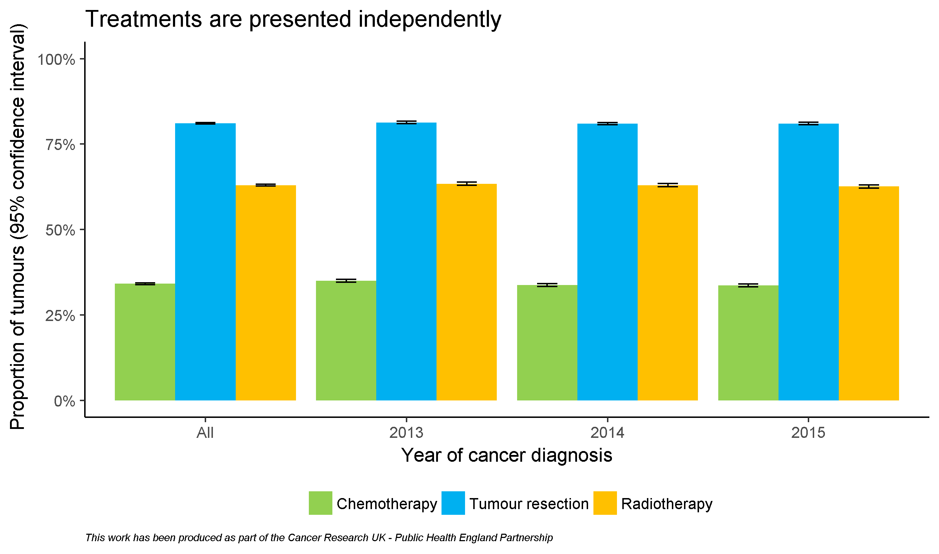
By diagnosis year

Slide 8
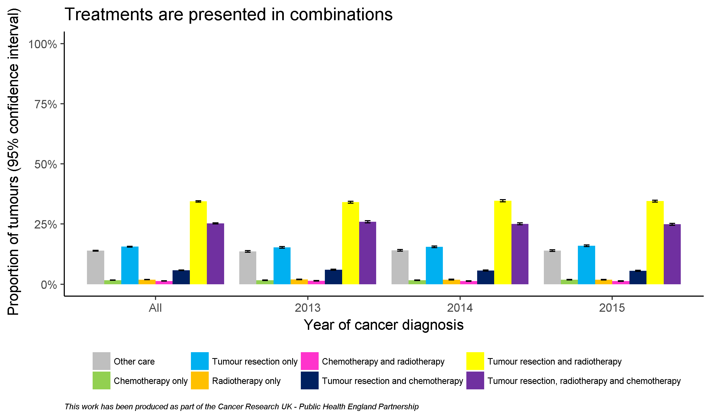
By diagnosis year

Slide 9
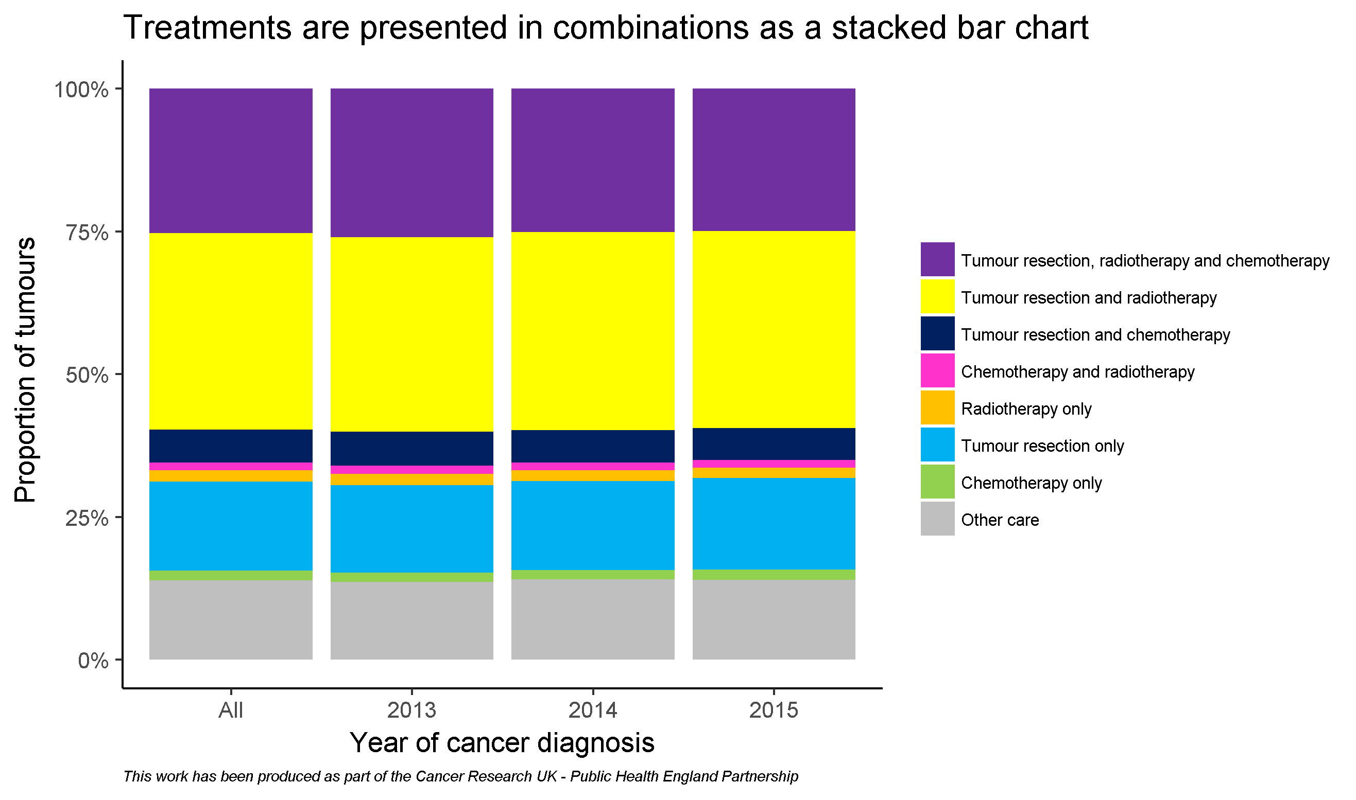
By diagnosis year

Slide 10
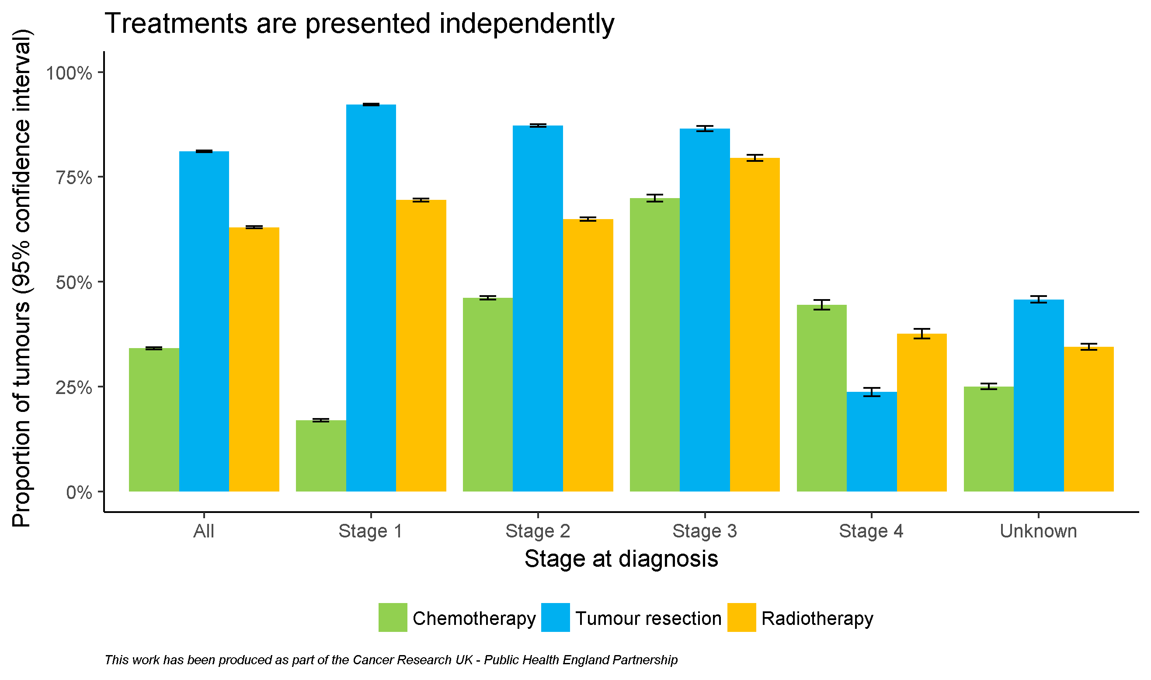
By stage

Slide 11
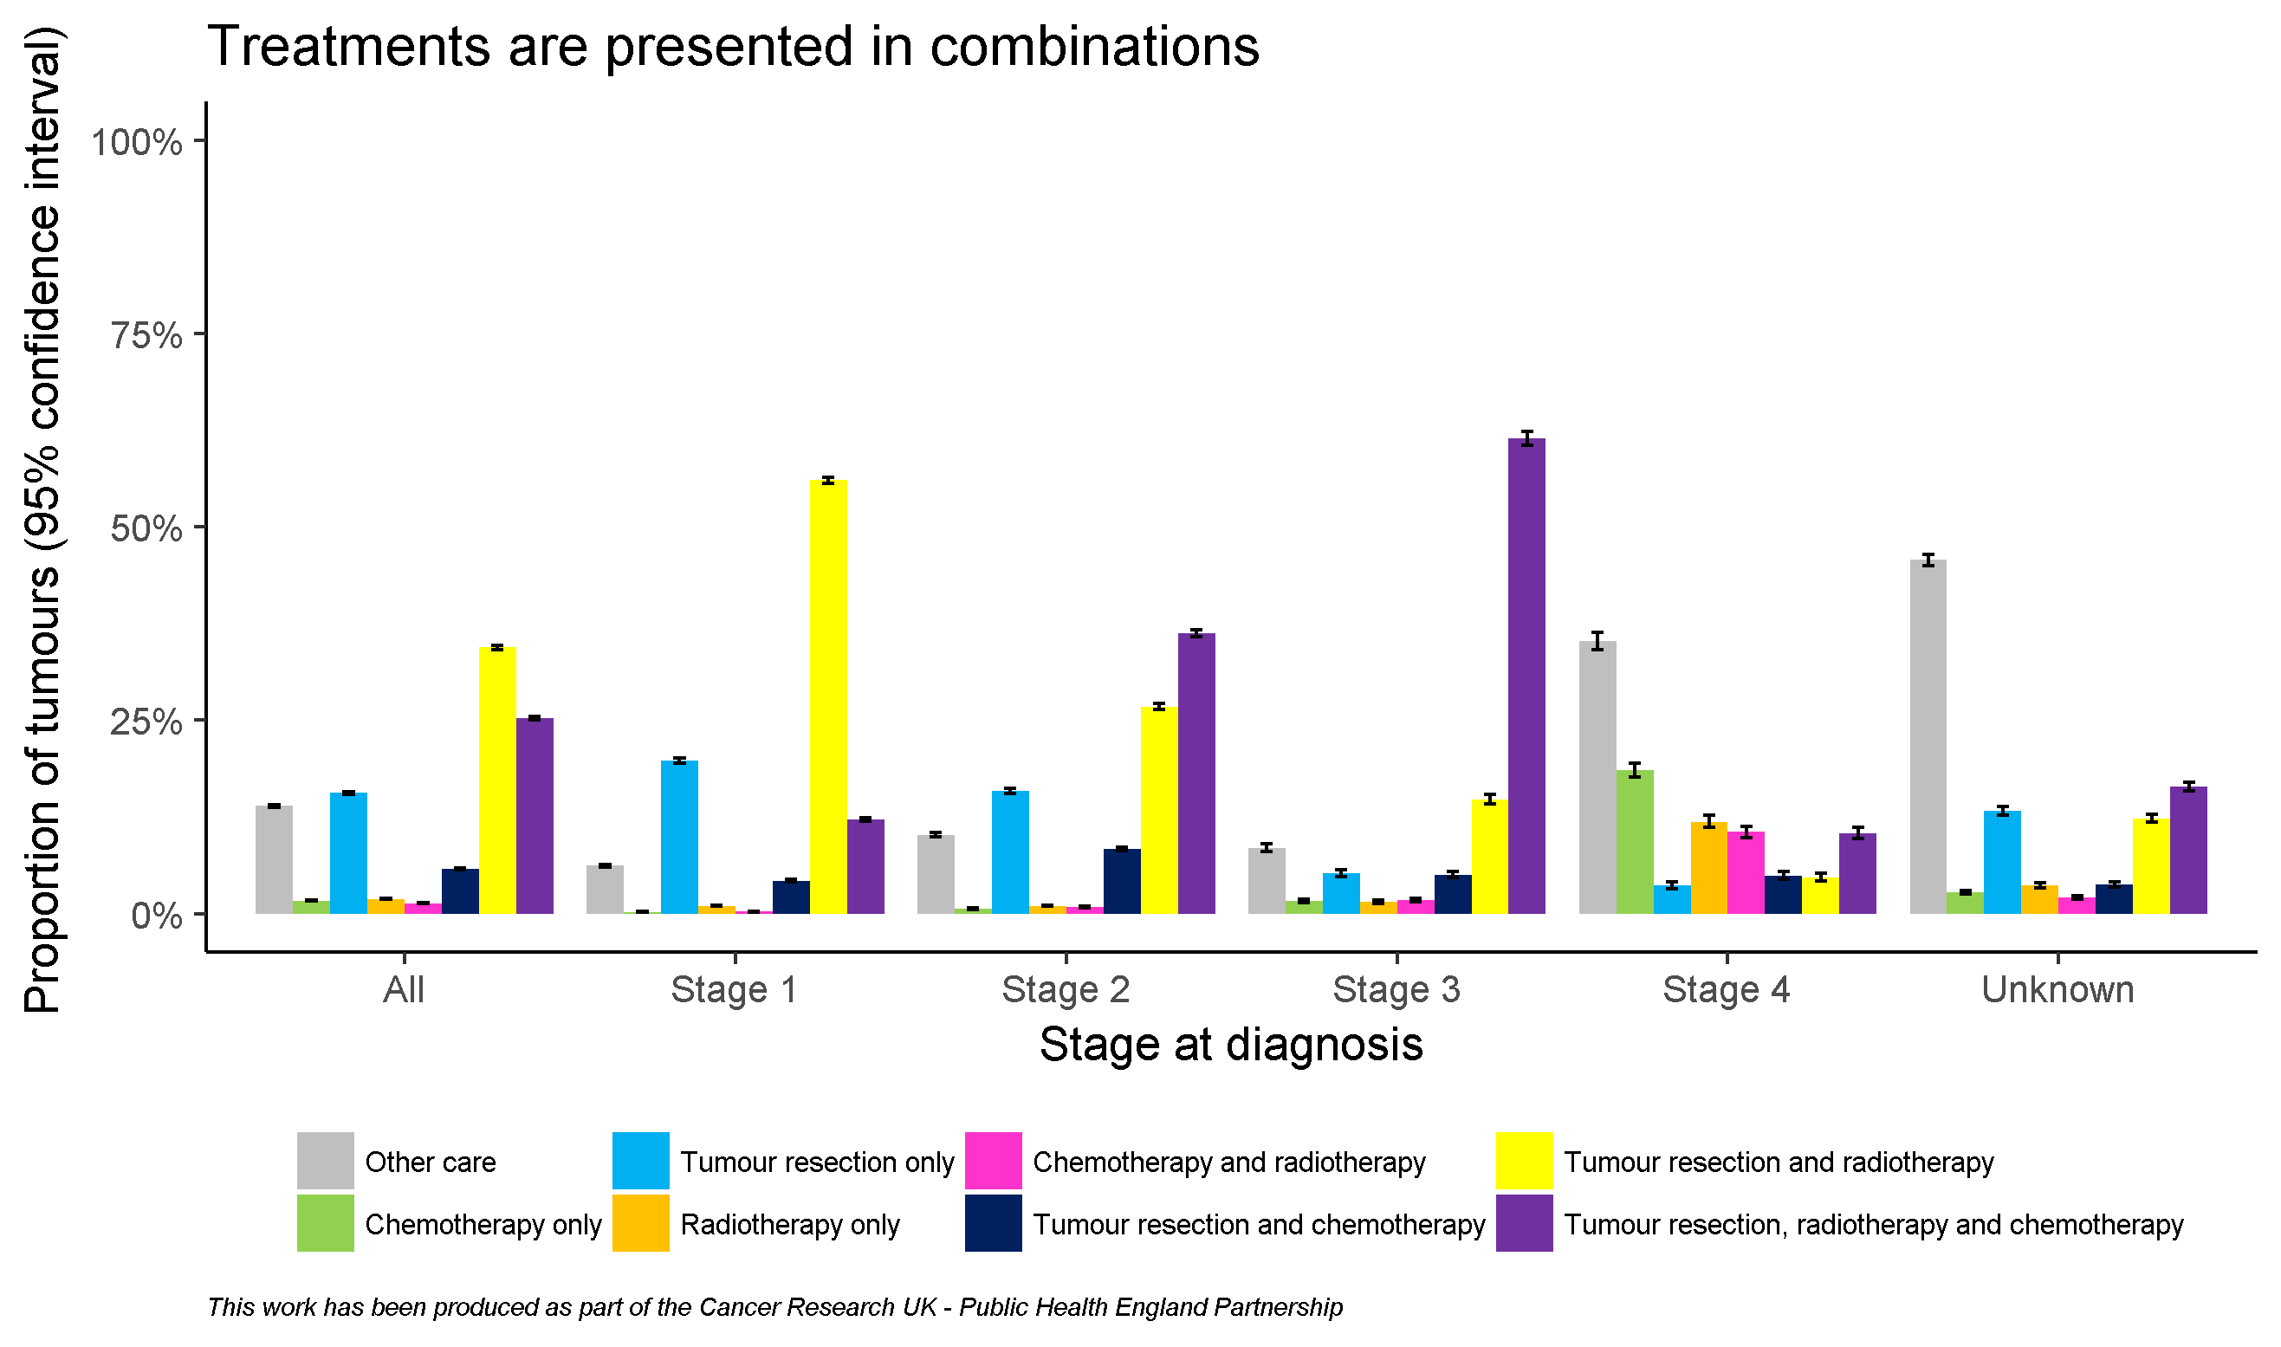
By stage

Slide 12
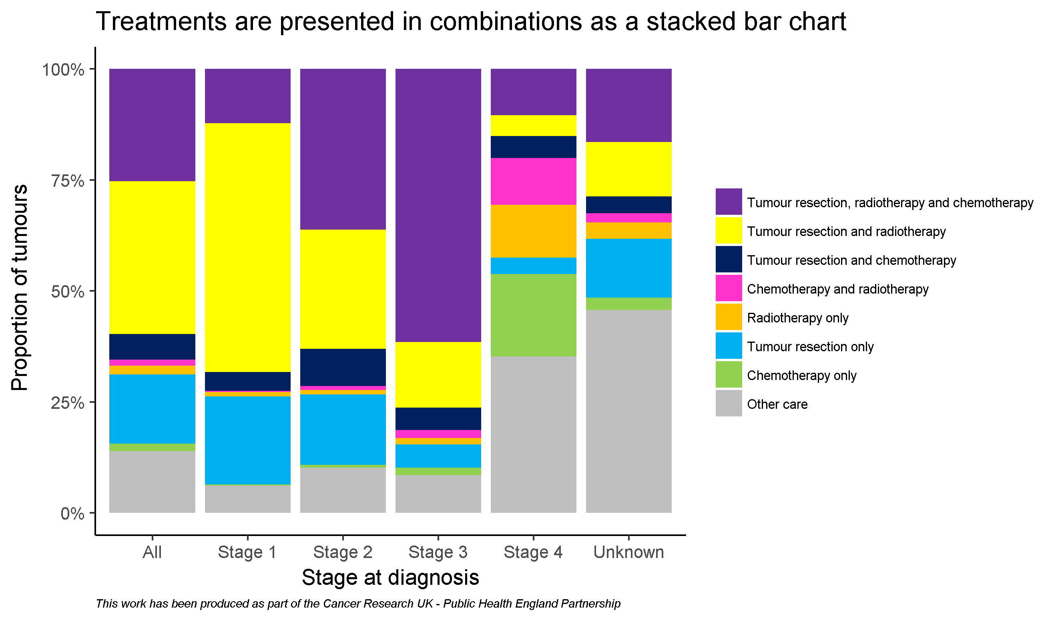
By stage

Slide 13
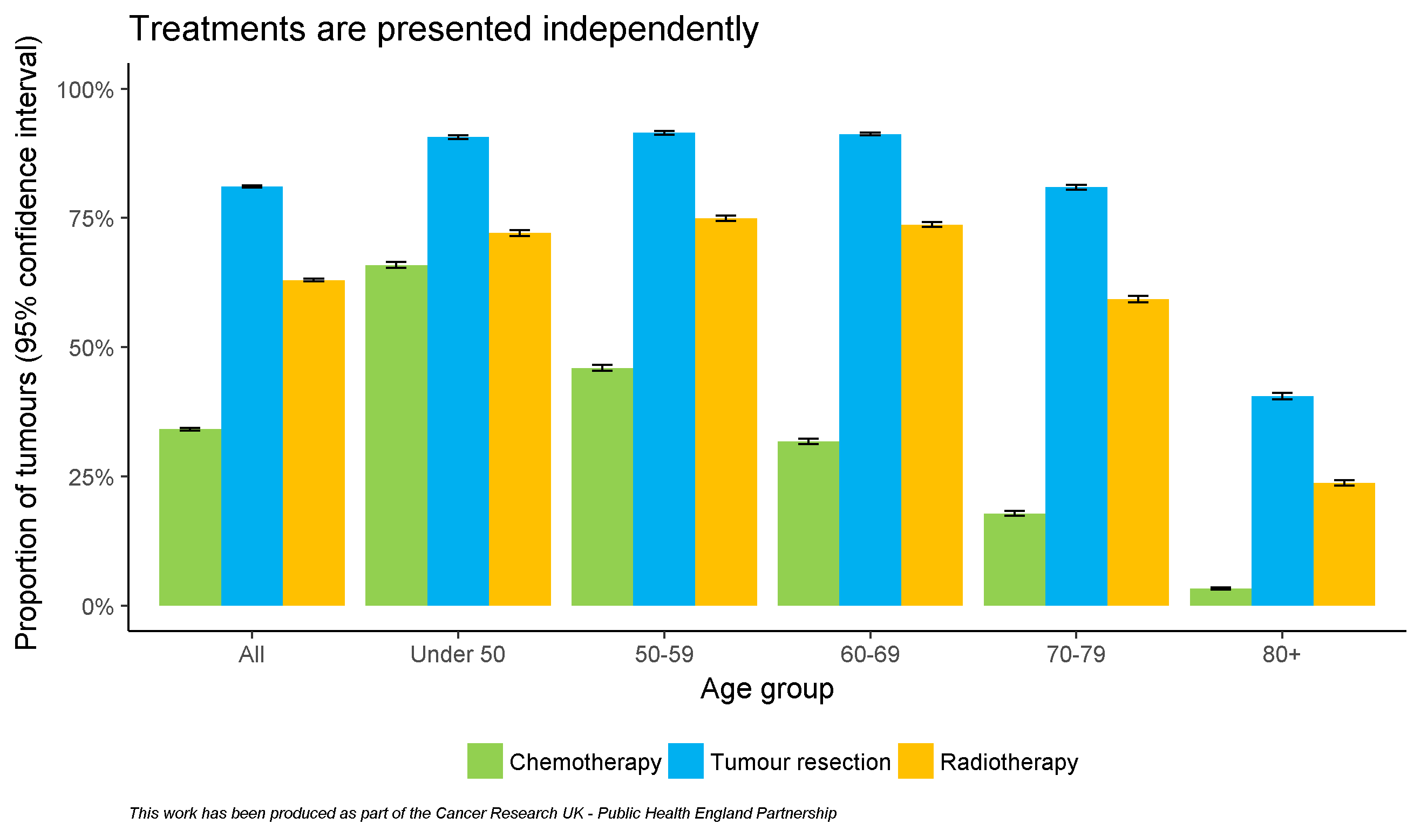
By age

Slide 14
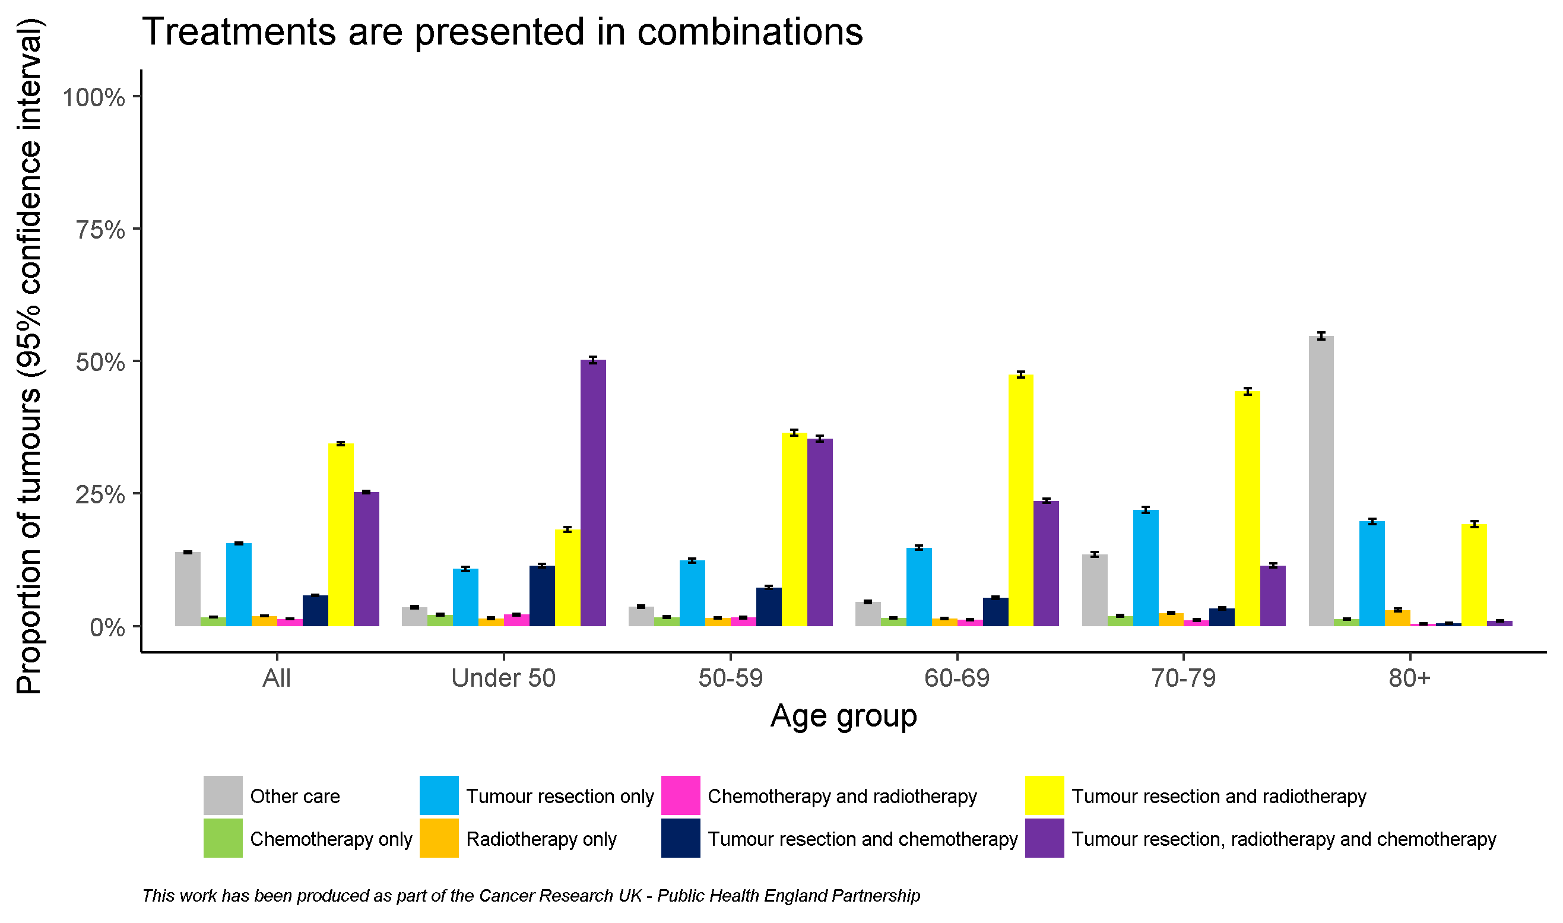
By age

Slide 15
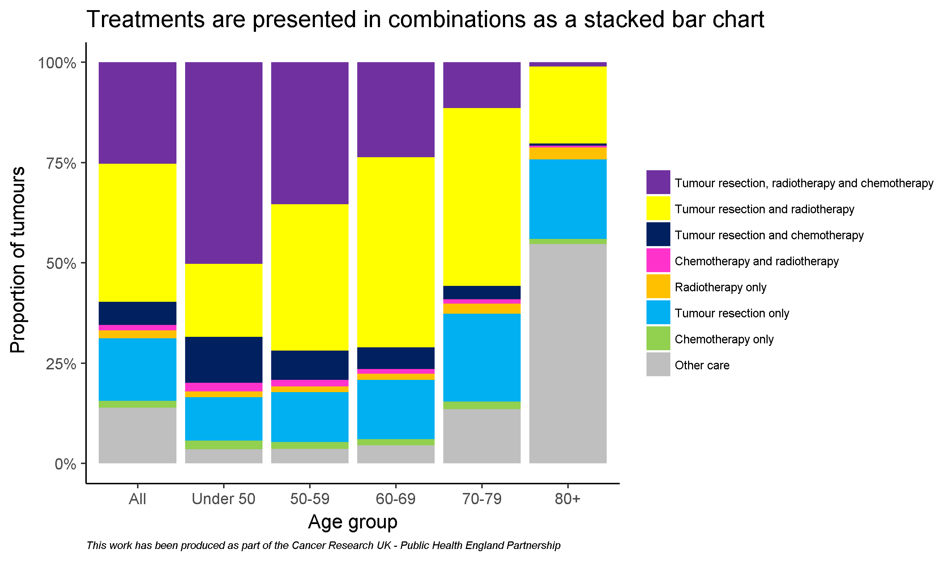
By age

Slide 16
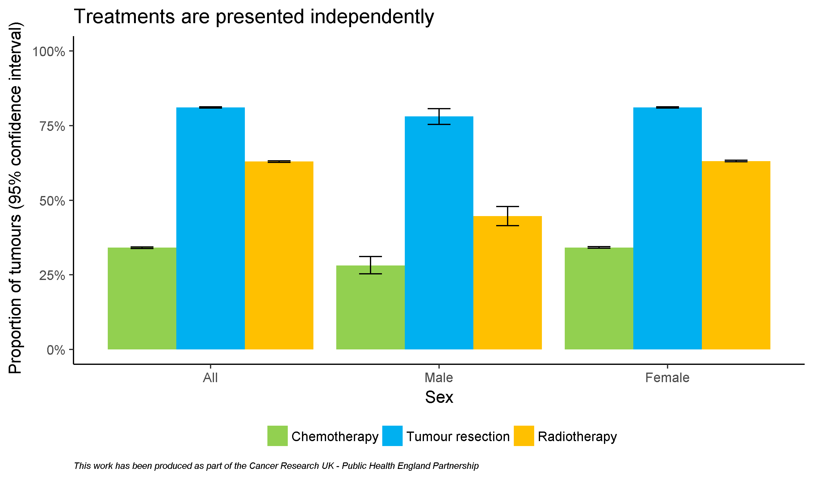
By sex

Slide 17
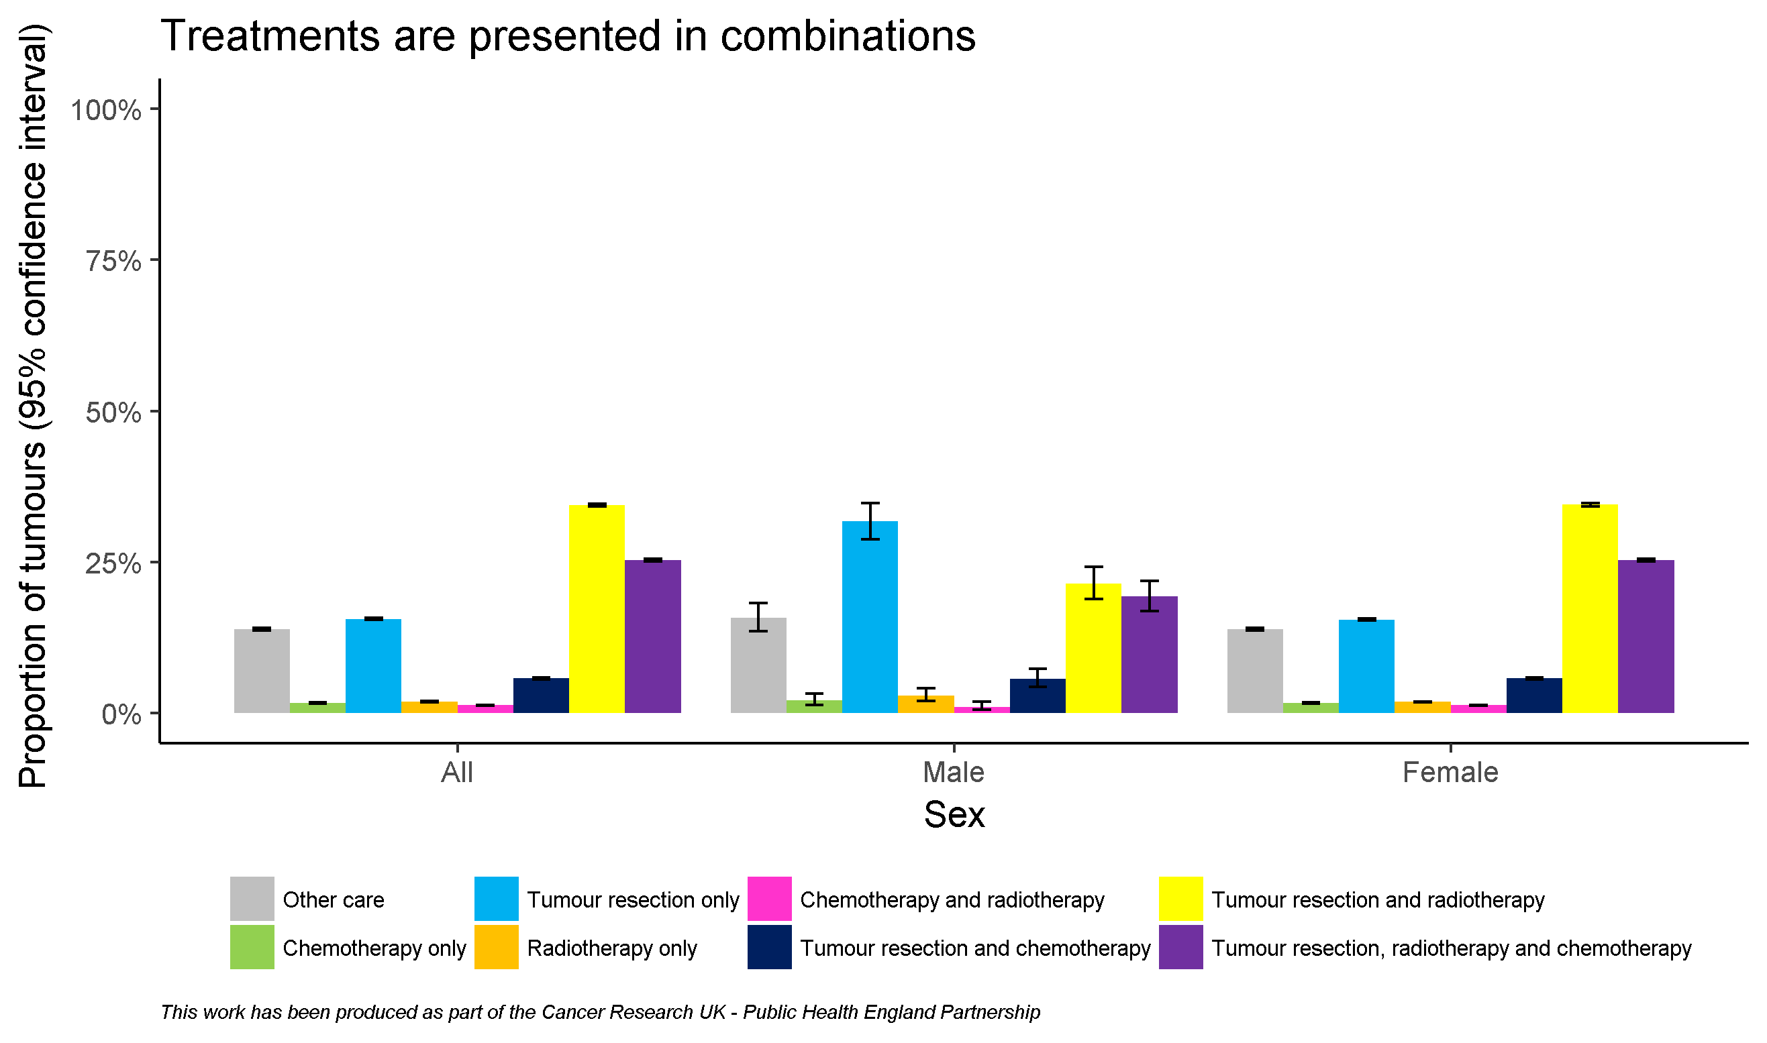
By sex

Slide 18
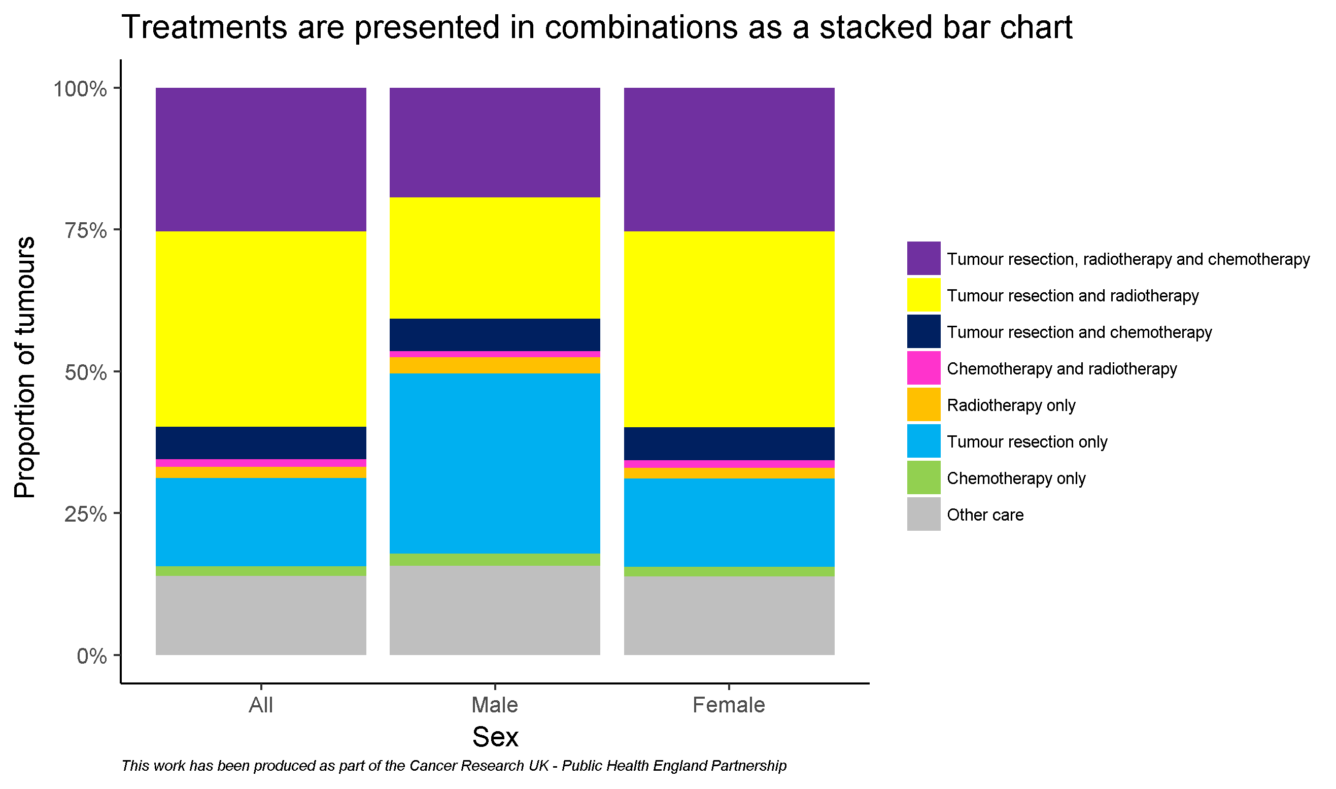
By sex

Slide 19
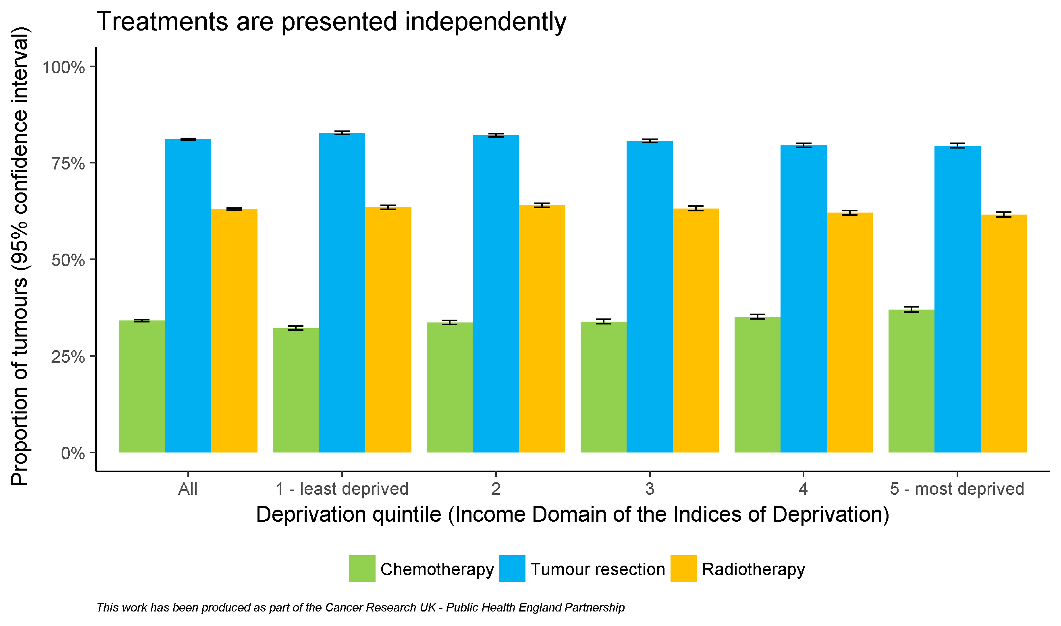
By deprivation quintile

Slide 20
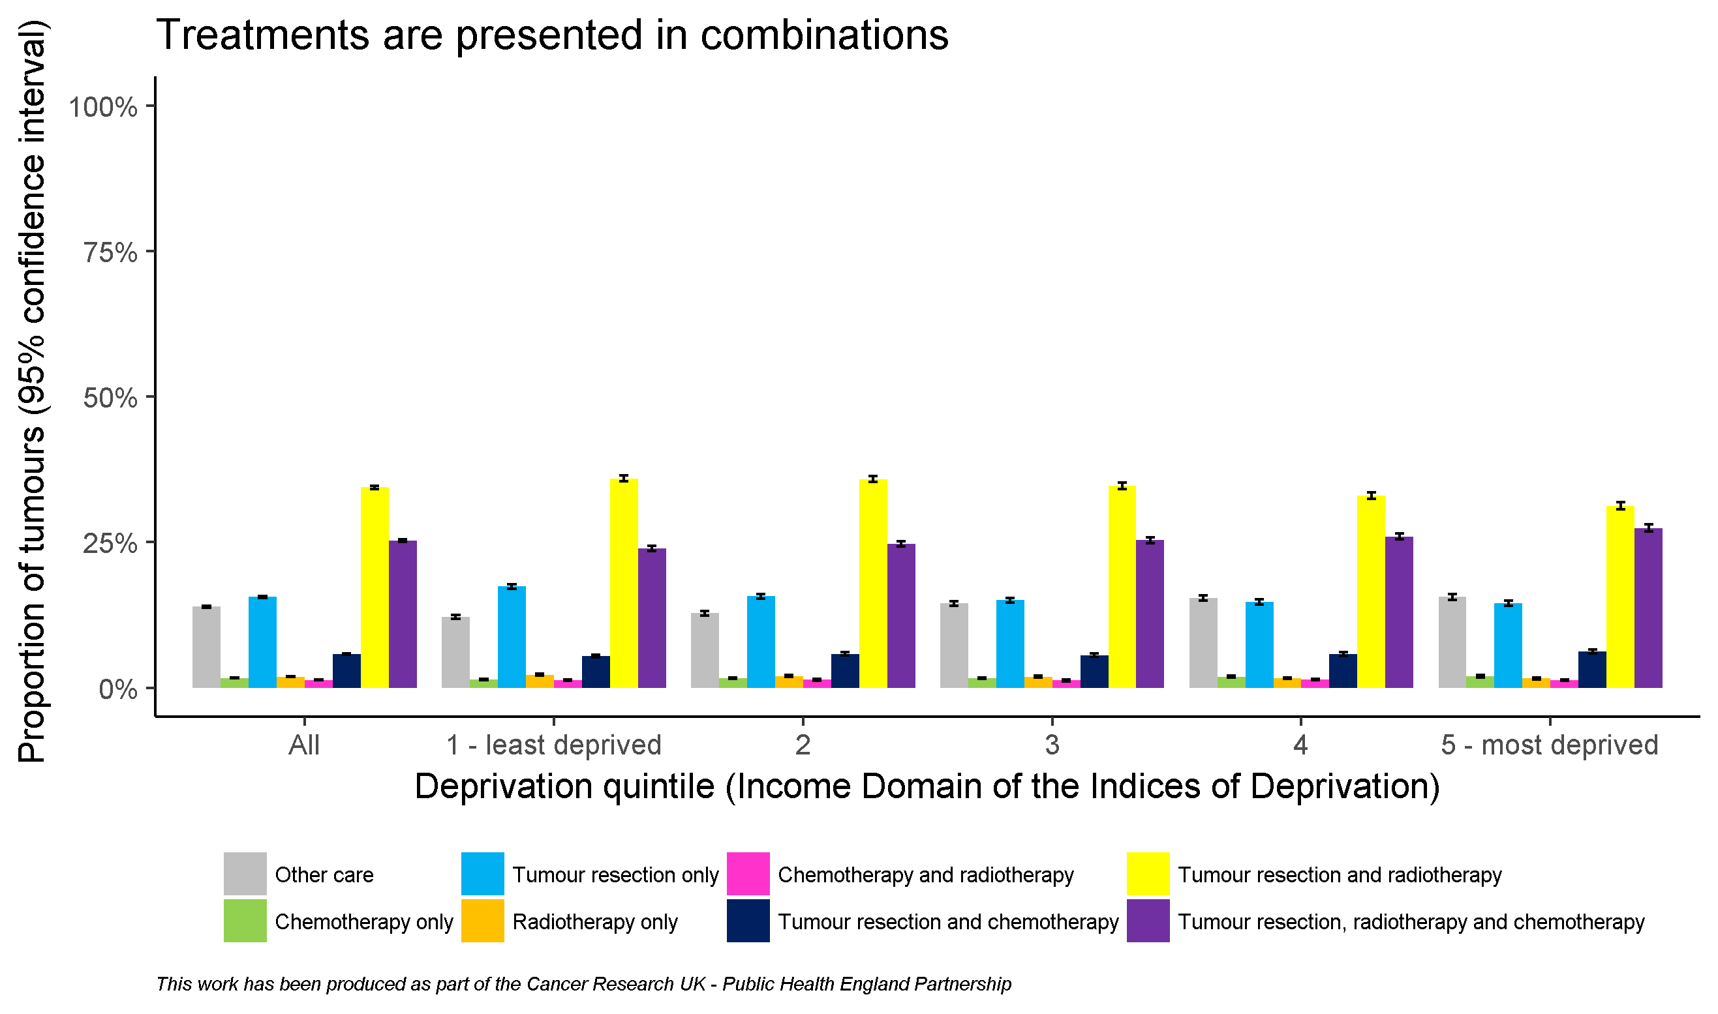
By deprivation quintile

Slide 21
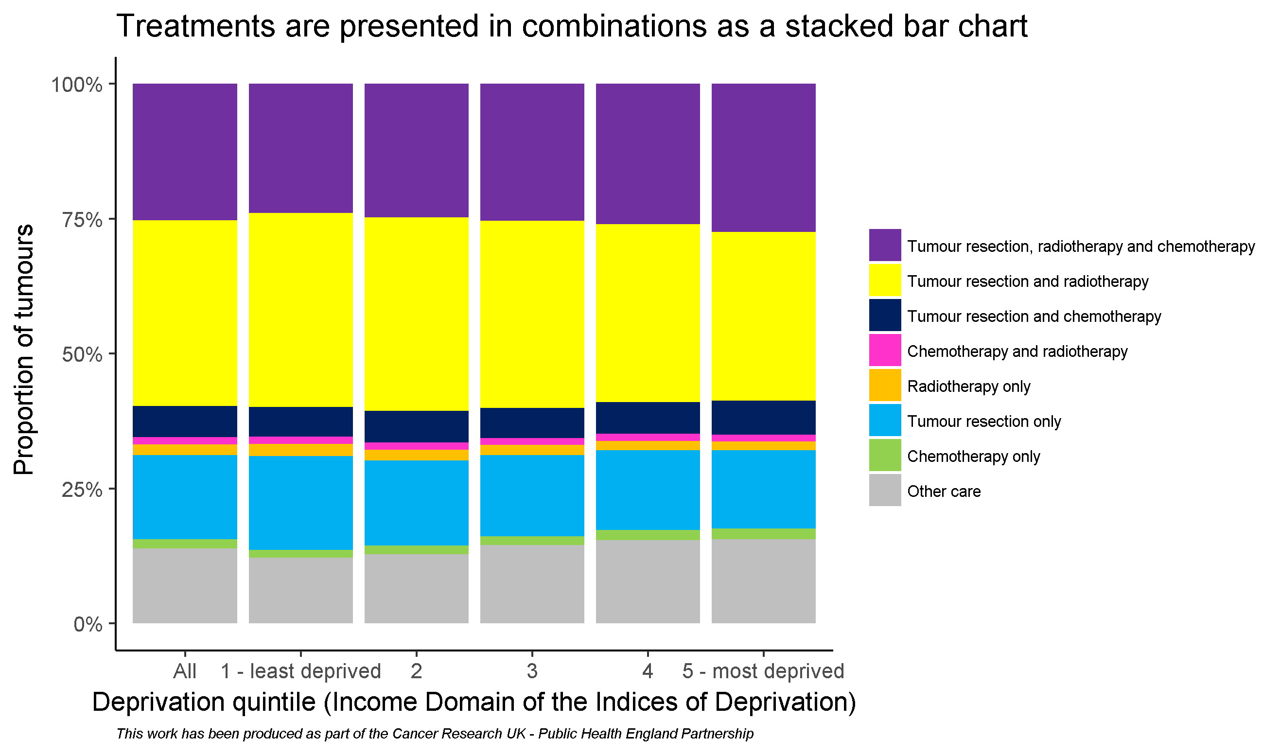
By deprivation quintile

Slide 22
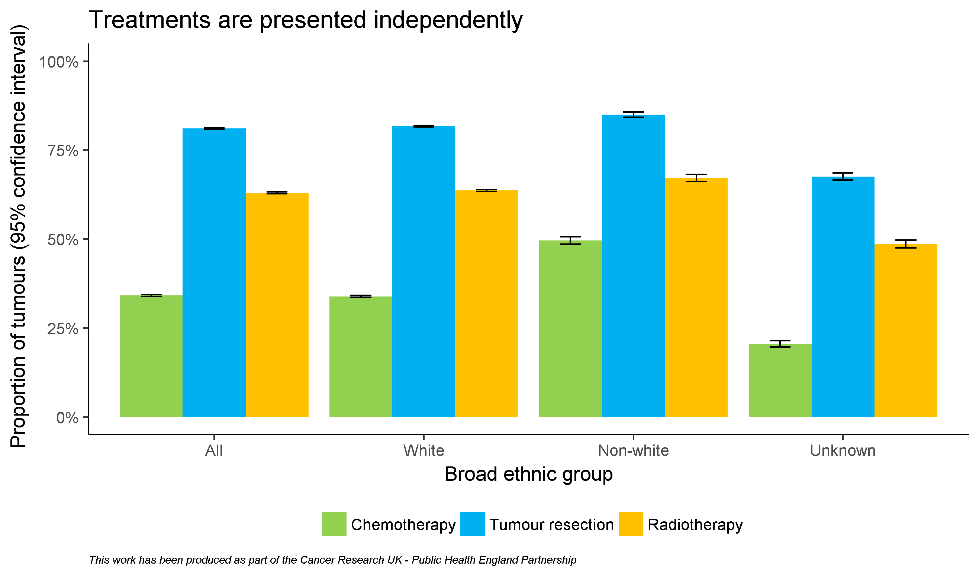
By broad ethnic group

Slide 23
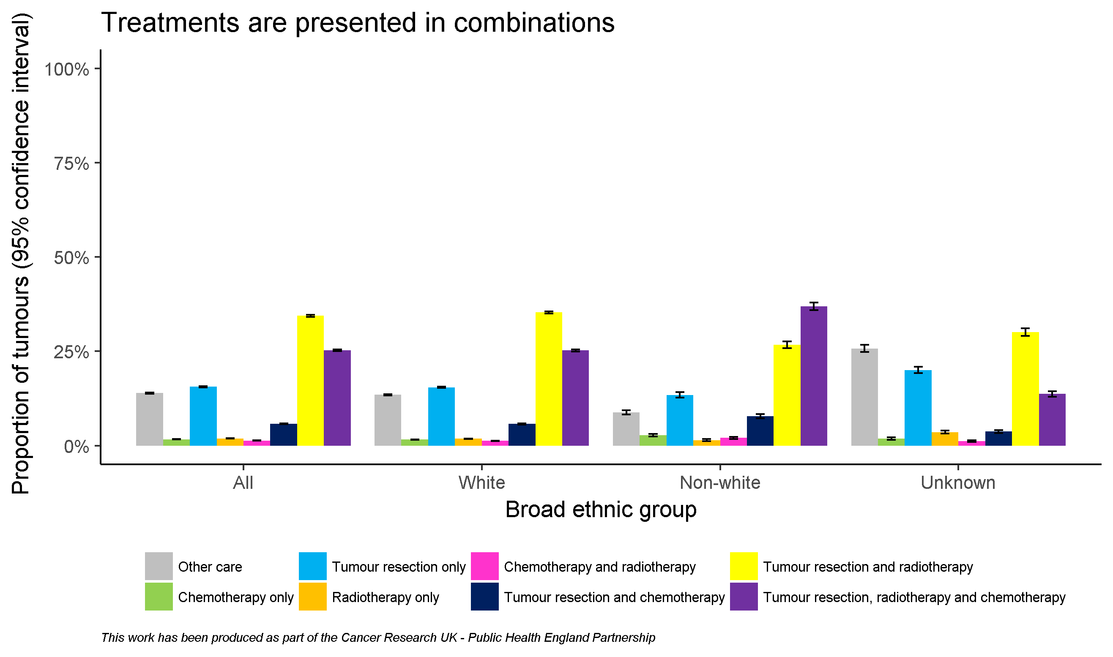
By broad ethnic group

Slide 24
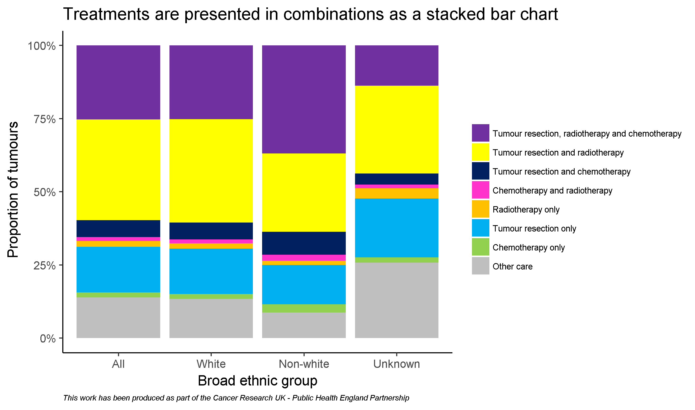
By broad ethnic group

Slide 25
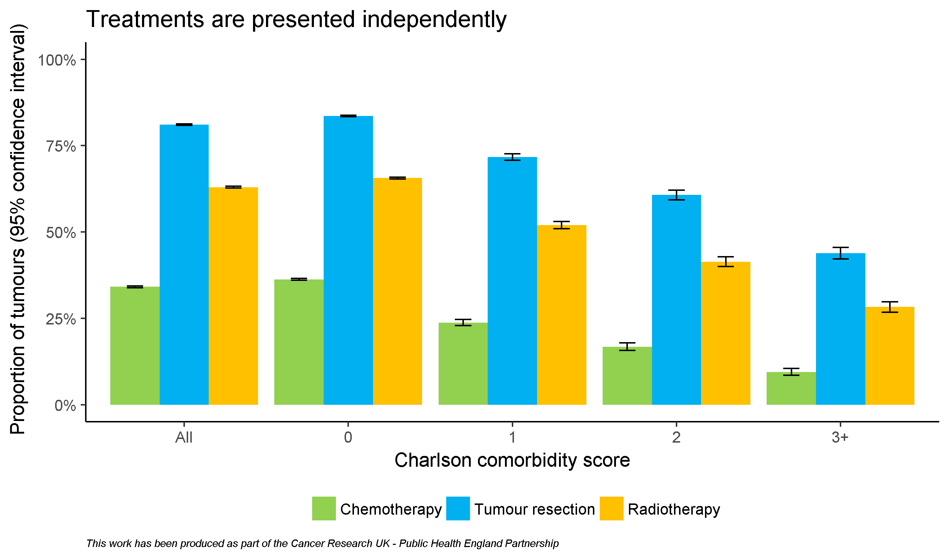
By comorbidity score

Slide 26
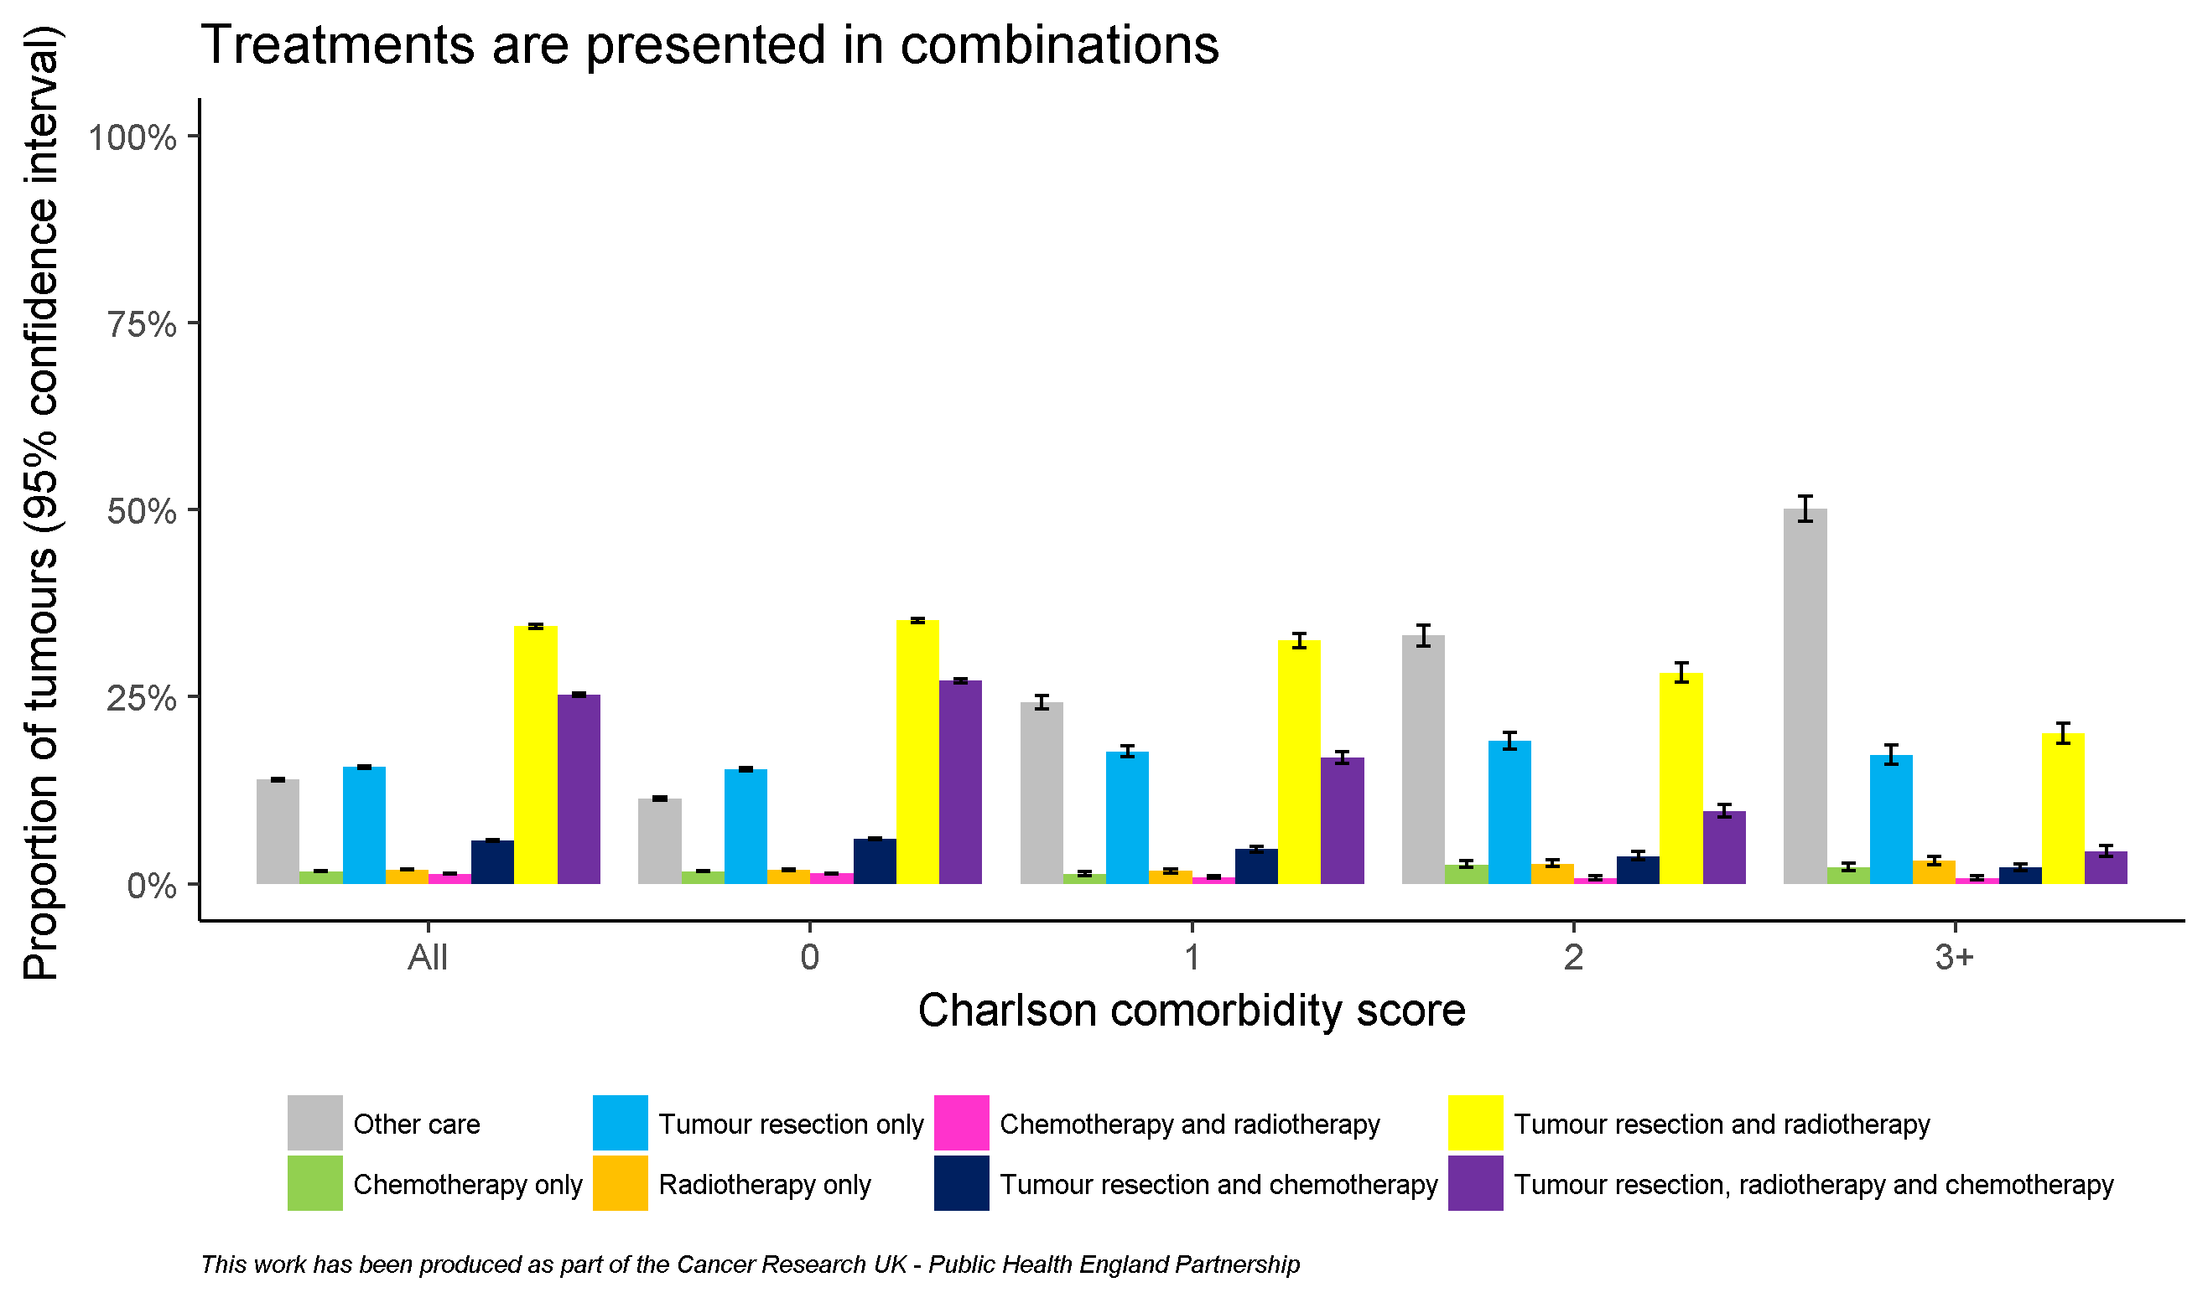
By comorbidity score

Slide 27
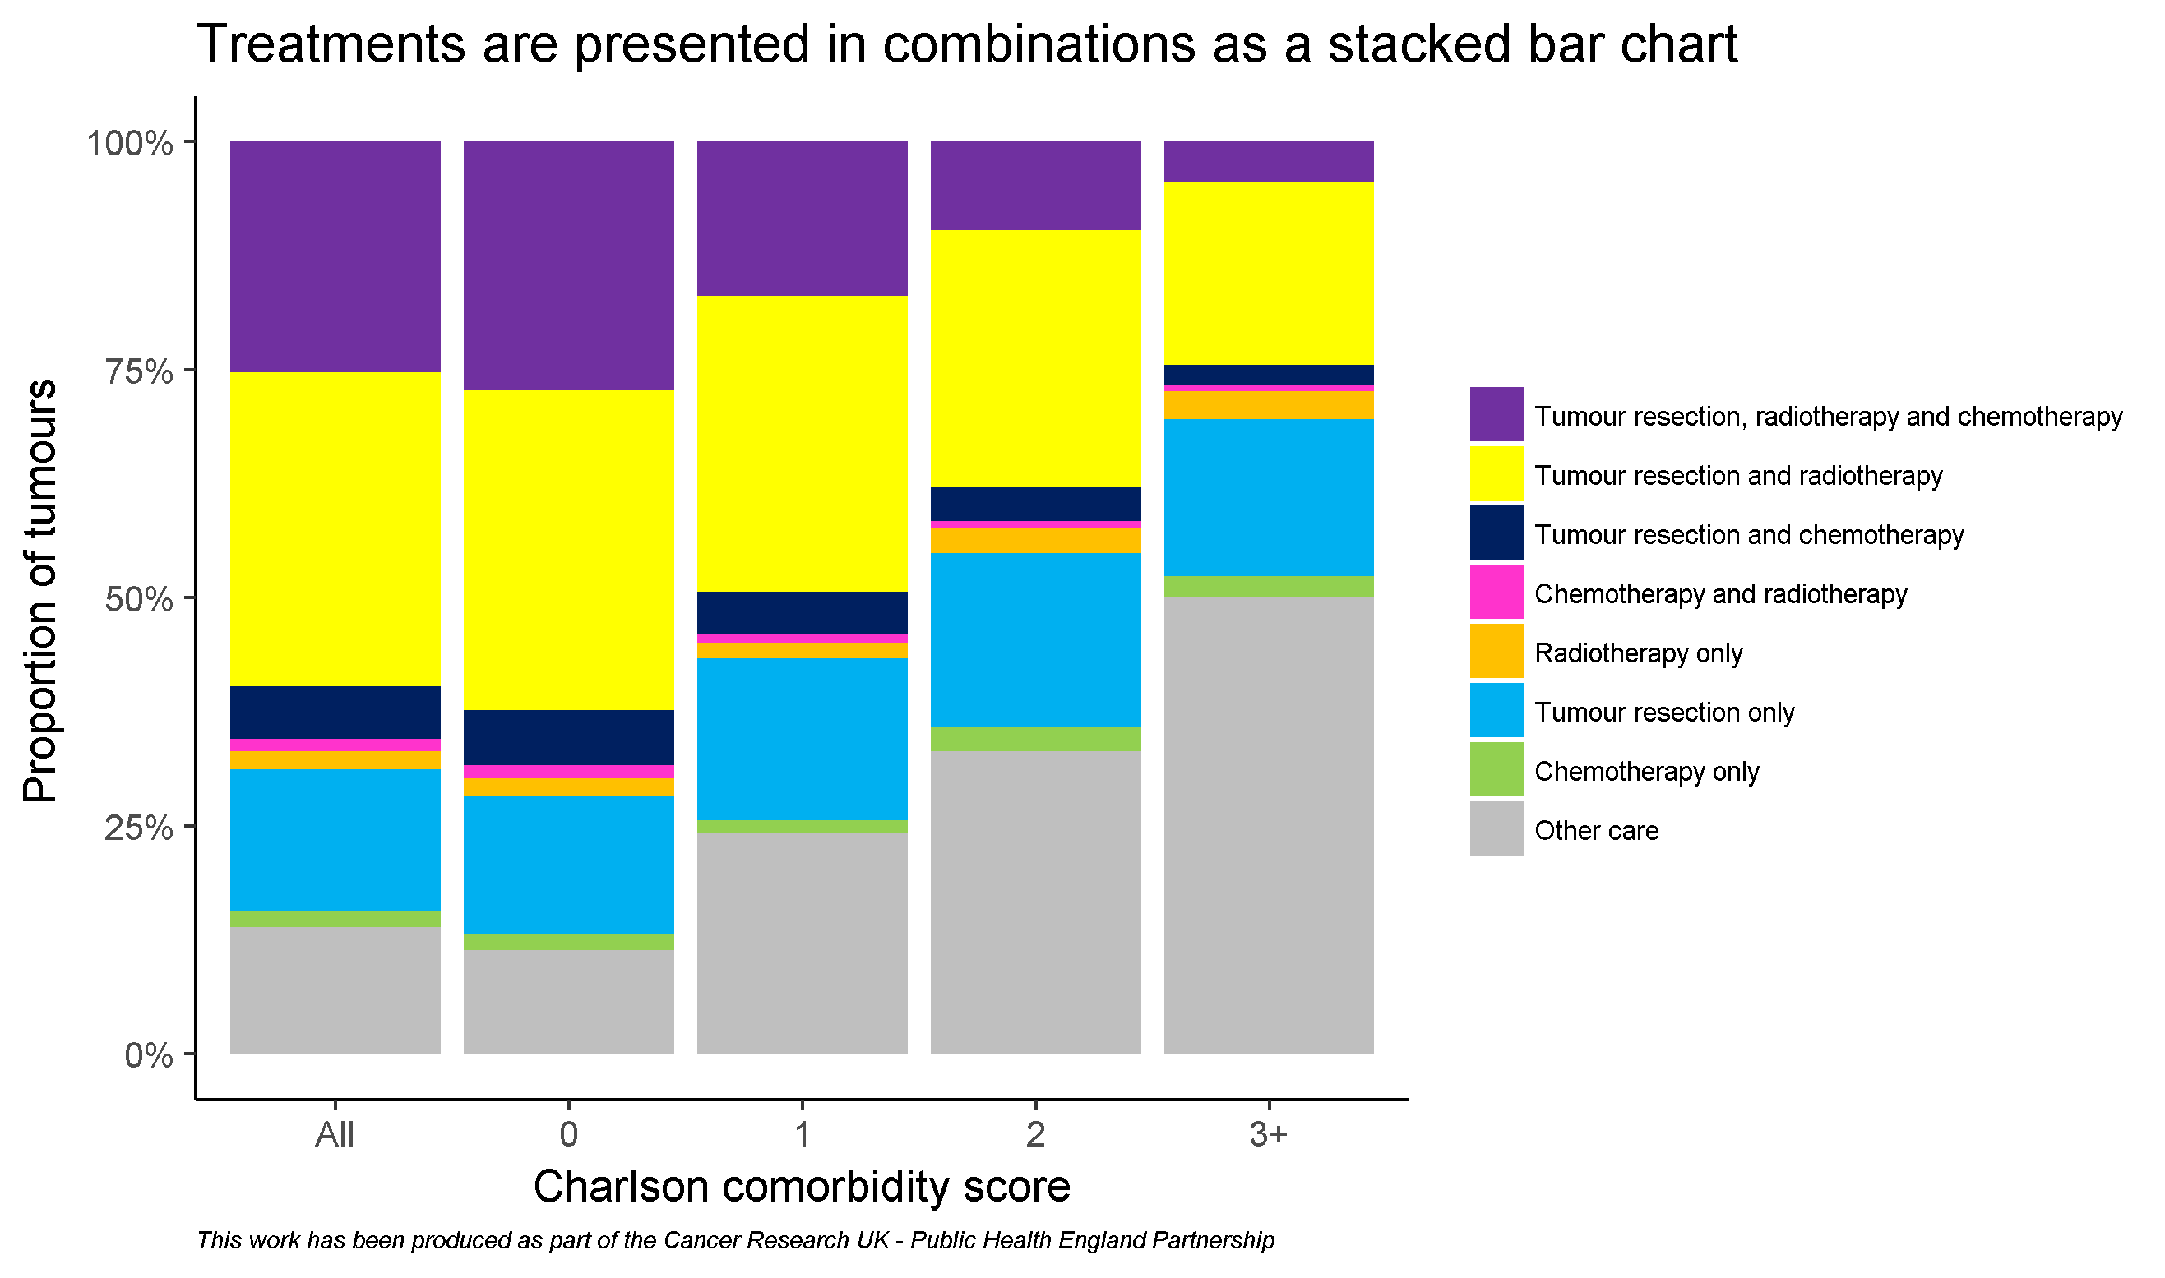
By comorbidity score

Slide 28
Acknowledgements
Public Health England and Cancer Research UK would like to thank the following analysts who developed this workbook:
Dr. Sean McPhail, Dr. Katherine Henson, Anna Fry, Becky White
We would like to thank the following analysts who contributed to the work:
Clare Pearson, Sabrina Sandhu, Carolynn Gildea, Jess Fraser, Michael Wallington, Cong Chen
We would also like to thank the following clinicians and analysts who offered feedback on this workbook or helped improve the tumour resections data featured in it:
Dr. Andy Nordin, Mr. Kieran Horgan, Mr. Ravinder Vohra,
Prof. Mick Peake, Prof. Eva Morris, Mr. Keith Roberts,
Mr. Graham Putnam, Dr. Roland Valori, Prof. Hemant Kocher,
Mr. Roger Kockelbergh, Prof. Paul Finan

