Slide 1
The national context for cancer intelligence.
National Cancer Intelligence Network

Slide 2
The Health & Social Care Act 2012: two new organisations from April 2013
NHS England
“The purpose of NHS England is to use the £80bn commissioning budget to secure the best possible outcomes for patients”
To ensure the whole commissioning architecture is in place; will also commission some services directly
Public Health England (PHE)
Information & Intelligence to support local Public Health (PH) organsiations and the public to make healthier choices
National Leadership to PH, supporting national policy
Development of PH workforce
A civil service function, not NHS

Slide 3
Cancer Task Force (CTF)
NHS England has established an independent taskforce
Chaired by Harpal Kumar, Chief Executive of Cancer Research UK
Aim: to develop a five-year action plan for cancer services
Wide consultation with a series of workshops
Access to, and use of, population-based data is one of its highest priorities
Five-year strategy to be published in summer 2015
Statement of Intent published in March 2015
http://www.cancerresearchuk.org/about-us/cancer-taskforce

Slide 4
CTF – statement of intent - key points
280,000 new diagnoses of cancer each year, growing by 2% per annum, resulting in an additional 80,000 new diagnoses by 2030
One year survival has increased to 70% (up from 60% in 2000), although this varies significantly between cancer types, and in England, survival still lags behind countries of similar wealth
On average, cancers are diagnosed at a more advanced stage in England than in other advanced countries
International comparisons have revealed that treatment rates with curative intent are lower in England than in other wealthy countries, and there is considerable variation in access to radical treatment
Although there is a high level of satisfaction with hospital care, patients often express frustration with the fragmentation of their care, and with the lack of information about their diagnosis and treatment

Slide 5
CTF – statement of intent – ambitions for the next five years
By 2020 - a discernable fall in age standardised incidence through prevention efforts
By 2020 adult smoking rates should have fallen much further
Increase in 5 and 10 year survival
Increases in 1 year survival with a reduction in variation between CCGs
Reduction in the survival deficit for older people
Continuous improvement in patient experience
Continuous improvement in long term quality of life
A majority of patients having been assessed as having a ‘good‘ death

Slide 6
Data Drivers
Government
A spotlight on the role of data and transparency
Commissioning
NHS Outcomes Framework
Regulation
New regulation framework (CQC & Monitor)
The ‘public’, patients and families
(e.g. ‘Friends and family test’)

Slide 7
Providers of information
Health & Social Care Information Centre
HSCIC
Office for National Statistics
ONS
UK and Ireland Cancer Registries UKIACR
National Audits
PHE
including
Health Intelligence Networks
NHS England Business Intelligence Teams
Incisive
Health
Macmillan Cancer Support
Cancer Research UK
Dr Foster and other intermediaries

Slide 8
Who do we produce intelligence for?
Clinicians & Clinical Teams
NHS England (e.g. specialist commissioning)
Clinical Commissioning Groups
Health Care Providers
NICE
CQC
Research Community
National Statistics
International Cancer Benchmarking Partnership
Patients and the public
Pharmaceutical Industry
Cancer charities

Slide 9
NHS England Specialised Commissioning Groups
B01. Radiotherapy
B02. PET-CT
B03. Specialised Cancer
B04. Blood & Marrow Transplantation
B05. Haemophilia and other bleeding disorders
B06. HIV
B07. Infectious Diseases
B08. Haemoglobinopathies
B09. Specialised Immunology and Allergy Services
B10. Thoracic Surgery
B11. Upper GI Surgery
B12. Sarcoma
B13. CNS Tumours
B14. Specialised Urology
B15. Chemotherapy
B16. Complex Head & Neck
B17. Teenage and Young People Cancer

Slide 10
NHS England Commissioning Groups (cont)
Lung
Breast
Colorectal
NCIN and NHS England have begun a process of co-ordinating Clinical Reference Group Meetings with the aim of aligning the metrics agenda across organisational boundaries

Slide 11
Cancer functions in Public Health England
Prevention (smoking; obesity; HPV vaccination, etc.)
Screening and its QA
Environmental aetiology (including cluster analyses)
Public Awareness Campaigns (Be Clear on Cancer Campaigns) – links with Local Authorities and Health & Well Being Boards
Cancer Intelligence:
Registration
Analysis
Reporting
Support (eg datasets, elearning)
PHE heavily involved in the Cancer Taskforce

Slide 12
Chief Knowledge Officer’s Directorate
CKO: John Newton
Research
Data
Information and Intelligence
Research and development
Deputy Director Bernadette Hannigan
National disease registration
Deputy Director Jem Rashbass
Knowledge and intelligence service
Deputy Director Peter Bradley
Digital
Business
Digital programme
Deputy Director
Diarmaid Crean
Business planning and commercial development
Deputy Director Sian Nash

Slide 13
National Cancer Registration Service
8 Regional Cancer Registries now incorporated into a National Cancer Registration Service for England
1 Director, 8 local offices
Complete migration ‘normalisation’ of 8 legacy systems with 11m cancer registrations to ENCORE
Same practice and processes, single national system
Standardised data, consistency, comparability & efficiency

Slide 14
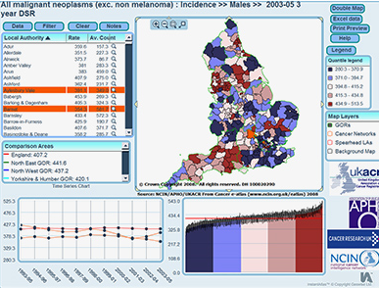
National Cancer Intelligence Network (2007 - )
5 aims :
Enabling use of cancer information to support audit and research programmes
Exploiting information to drive improvements in cancer care and clinical outcomes
Providing a common national repository for cancer datasets
Producing expert analyses to monitor patterns of cancer care
Promoting efficient and effective data collection
Goal for NCIN: “To develop the best cancer information service of any large country in the world – by 2012”
For more information about the PHE NCIN visit www.ncin.org.uk

Slide 15
Clinical Commissioning Group Outcomes Indicator Set (for cancer)
2013/14 under 75 mortality rate from cancer
1 and 5 year survival from all cancers
1 and 5 year survival from breast, lung & colorectal cancers
2014/15 additional indicators for cancer
cancers diagnosed via emergency routes
5 year survival - children
cancer stage at diagnosis
cancers detected at stage 1 or 2
1 and 5 yr survival for lung, breast and colorectal cancers

Slide 16
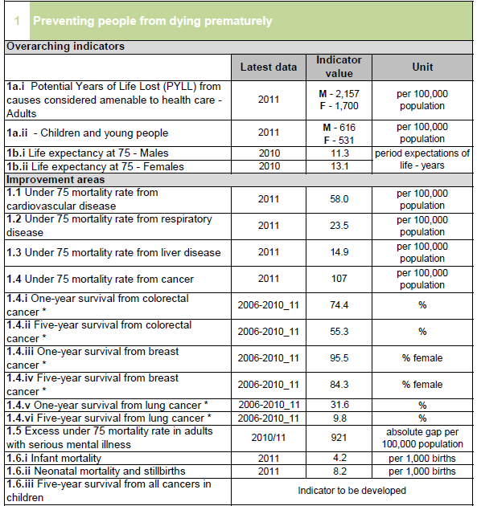
NHS Outcome Framework 2013/14 Dashboard

Slide 17
NHS Outcome Framework 2013/14 Dashboard

Slide 18
HSCIC Indicator Portal

Slide 19
Examples of the clinical value of new data
Supporting ‘intelligent commissioning’
Demonstration of variation
Teasing out the causes of variation
Demonstrating value of specialisation
Building data into quality improvement
Adding outcome data into Quality Surveillance Team (Peer Review)
More meaningful regulation - CQC
Providing robust evidence behind National Guidelines and Quality Standards (NICE)
Supporting Clinical Trials

Slide 20
Conclusions
The quality and range of clinically relevant data on cancer is increasing rapidly
The collection and intelligent use of data are at the heart of good clinical practice and commissioning
We now have a large and expanding clinical and patient community engaged with cancer data
Feedback and ongoing interaction with clinicians is an essential part of the process – peer pressure is powerful
There is a need to improve how information is used at a local level, and we hope this roadshow can help to achieve that.

